Slide 1
Task description
Agile Development Processes 2014
Eric Knauss

Slide 2
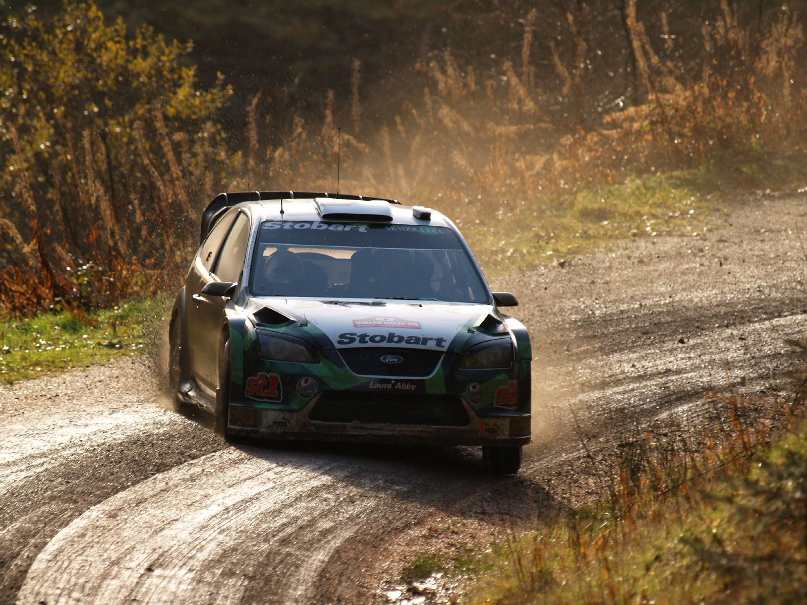
Pair programming
Navigator
Driver
Task
http://upload.wikimedia.org/wikipedia/commons/b/bd/Jari-Matti_Latvala-2007_Wales_Rally_GB_001.jpg

Slide 3

We know the tools of the driver…
https://flic.kr/p/77rfcL

Slide 4
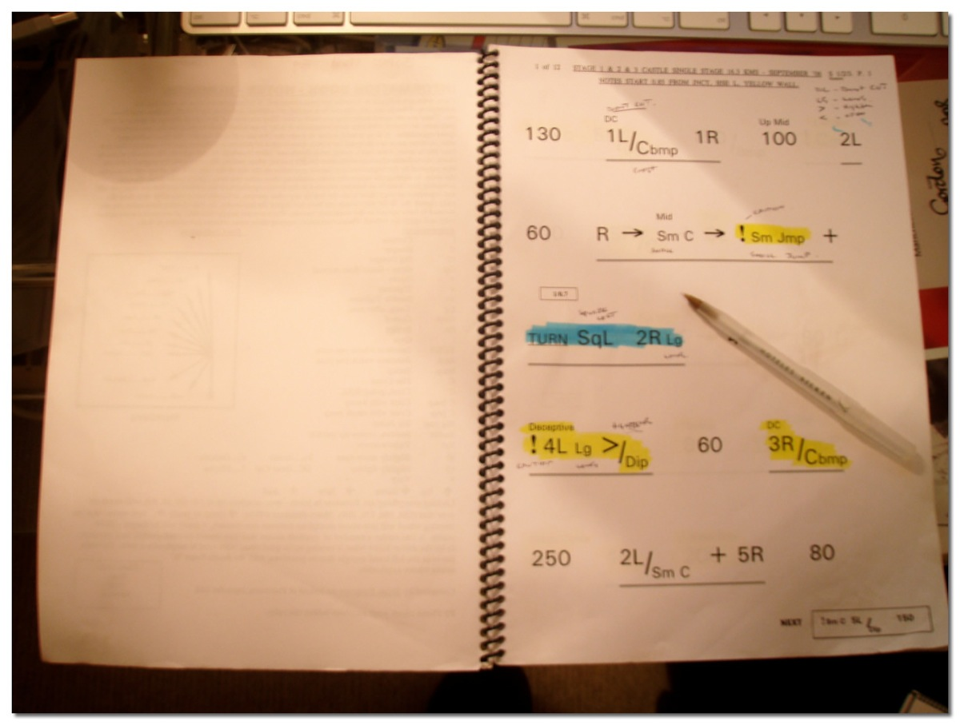
It is time to take care of the navigator…
http://en.wikipedia.org/wiki/File:Pacenotes.jpg

Slide 5
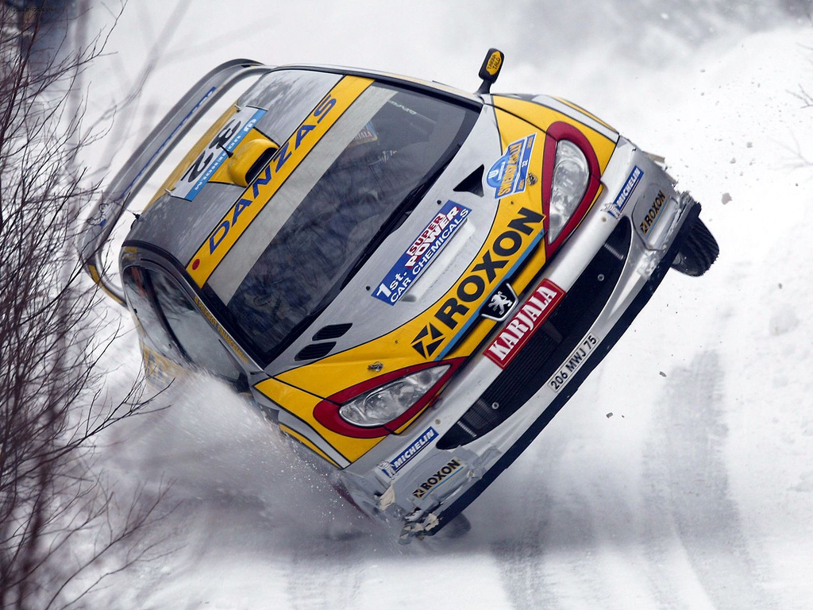

Task: Pair Programming Pacenotes
Rally
Pair Programming
http://civic.mit.edu/blog/natematias/pair-research-low-fi-tools-for-collaboration-in-teams
http://en.wikipedia.org/wiki/File:Peugeot_206_WRC.jpg
Primary
Know road conditions
Know position of other teams
Primary
Know state of master branch
Know position of other teams
Secondary
Prepare for track
Measure/analyze performance
Secondary
Support planning game
Measure/analyze velocity

